Slide 1

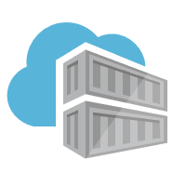
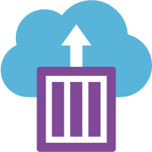
Introduction to Containers, Docker, ACR, and ACI
By: Tariq Abubaker

Slide 2
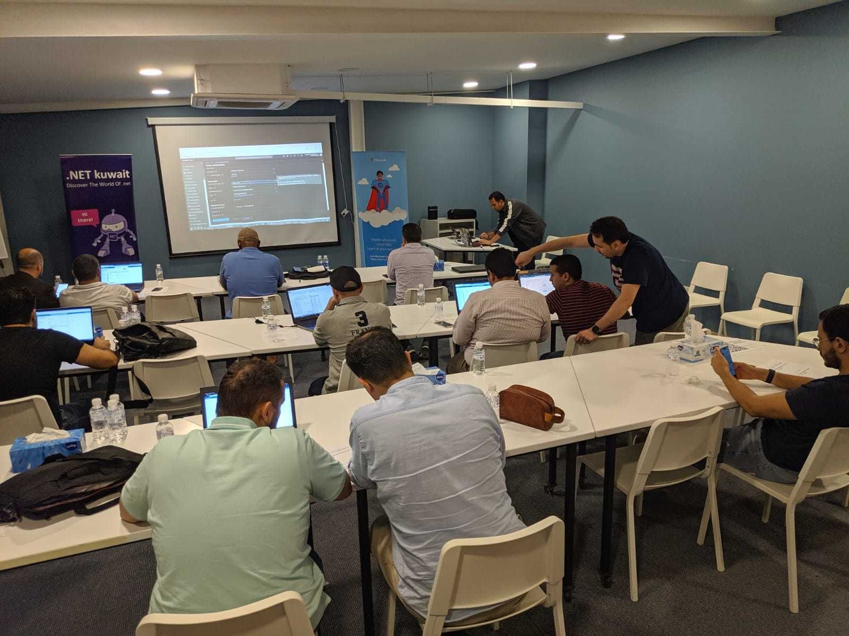
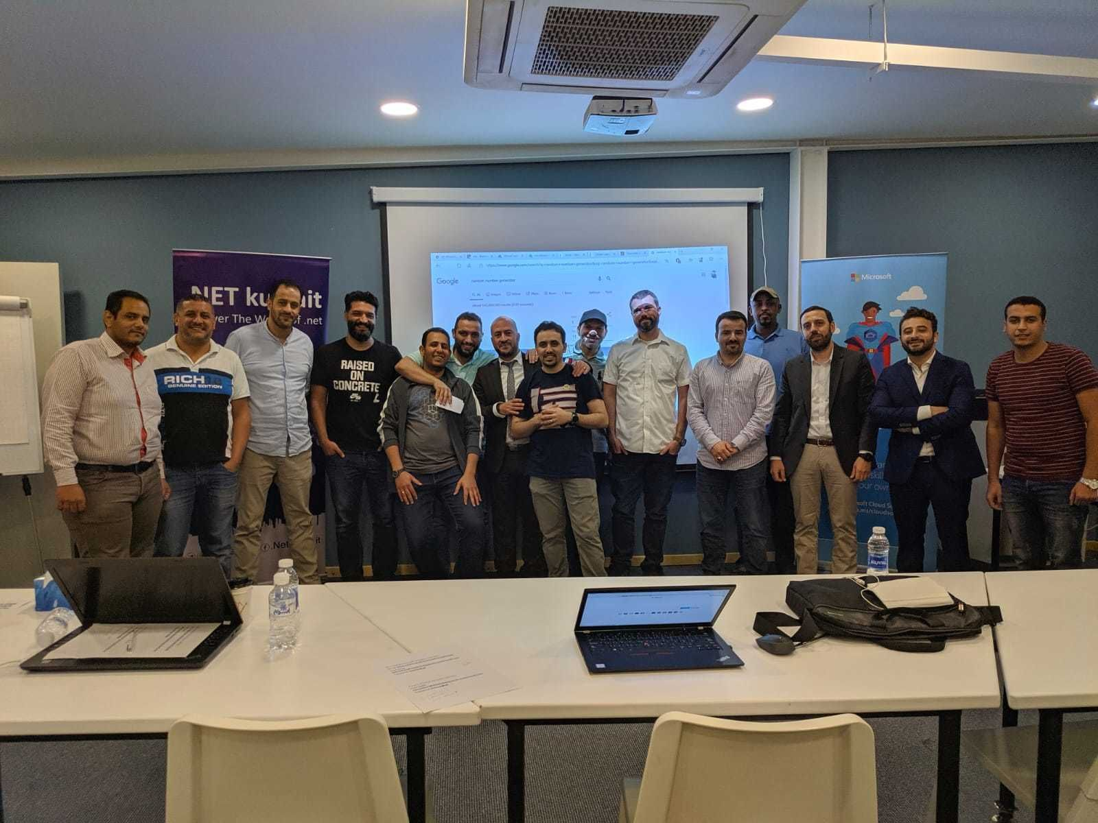
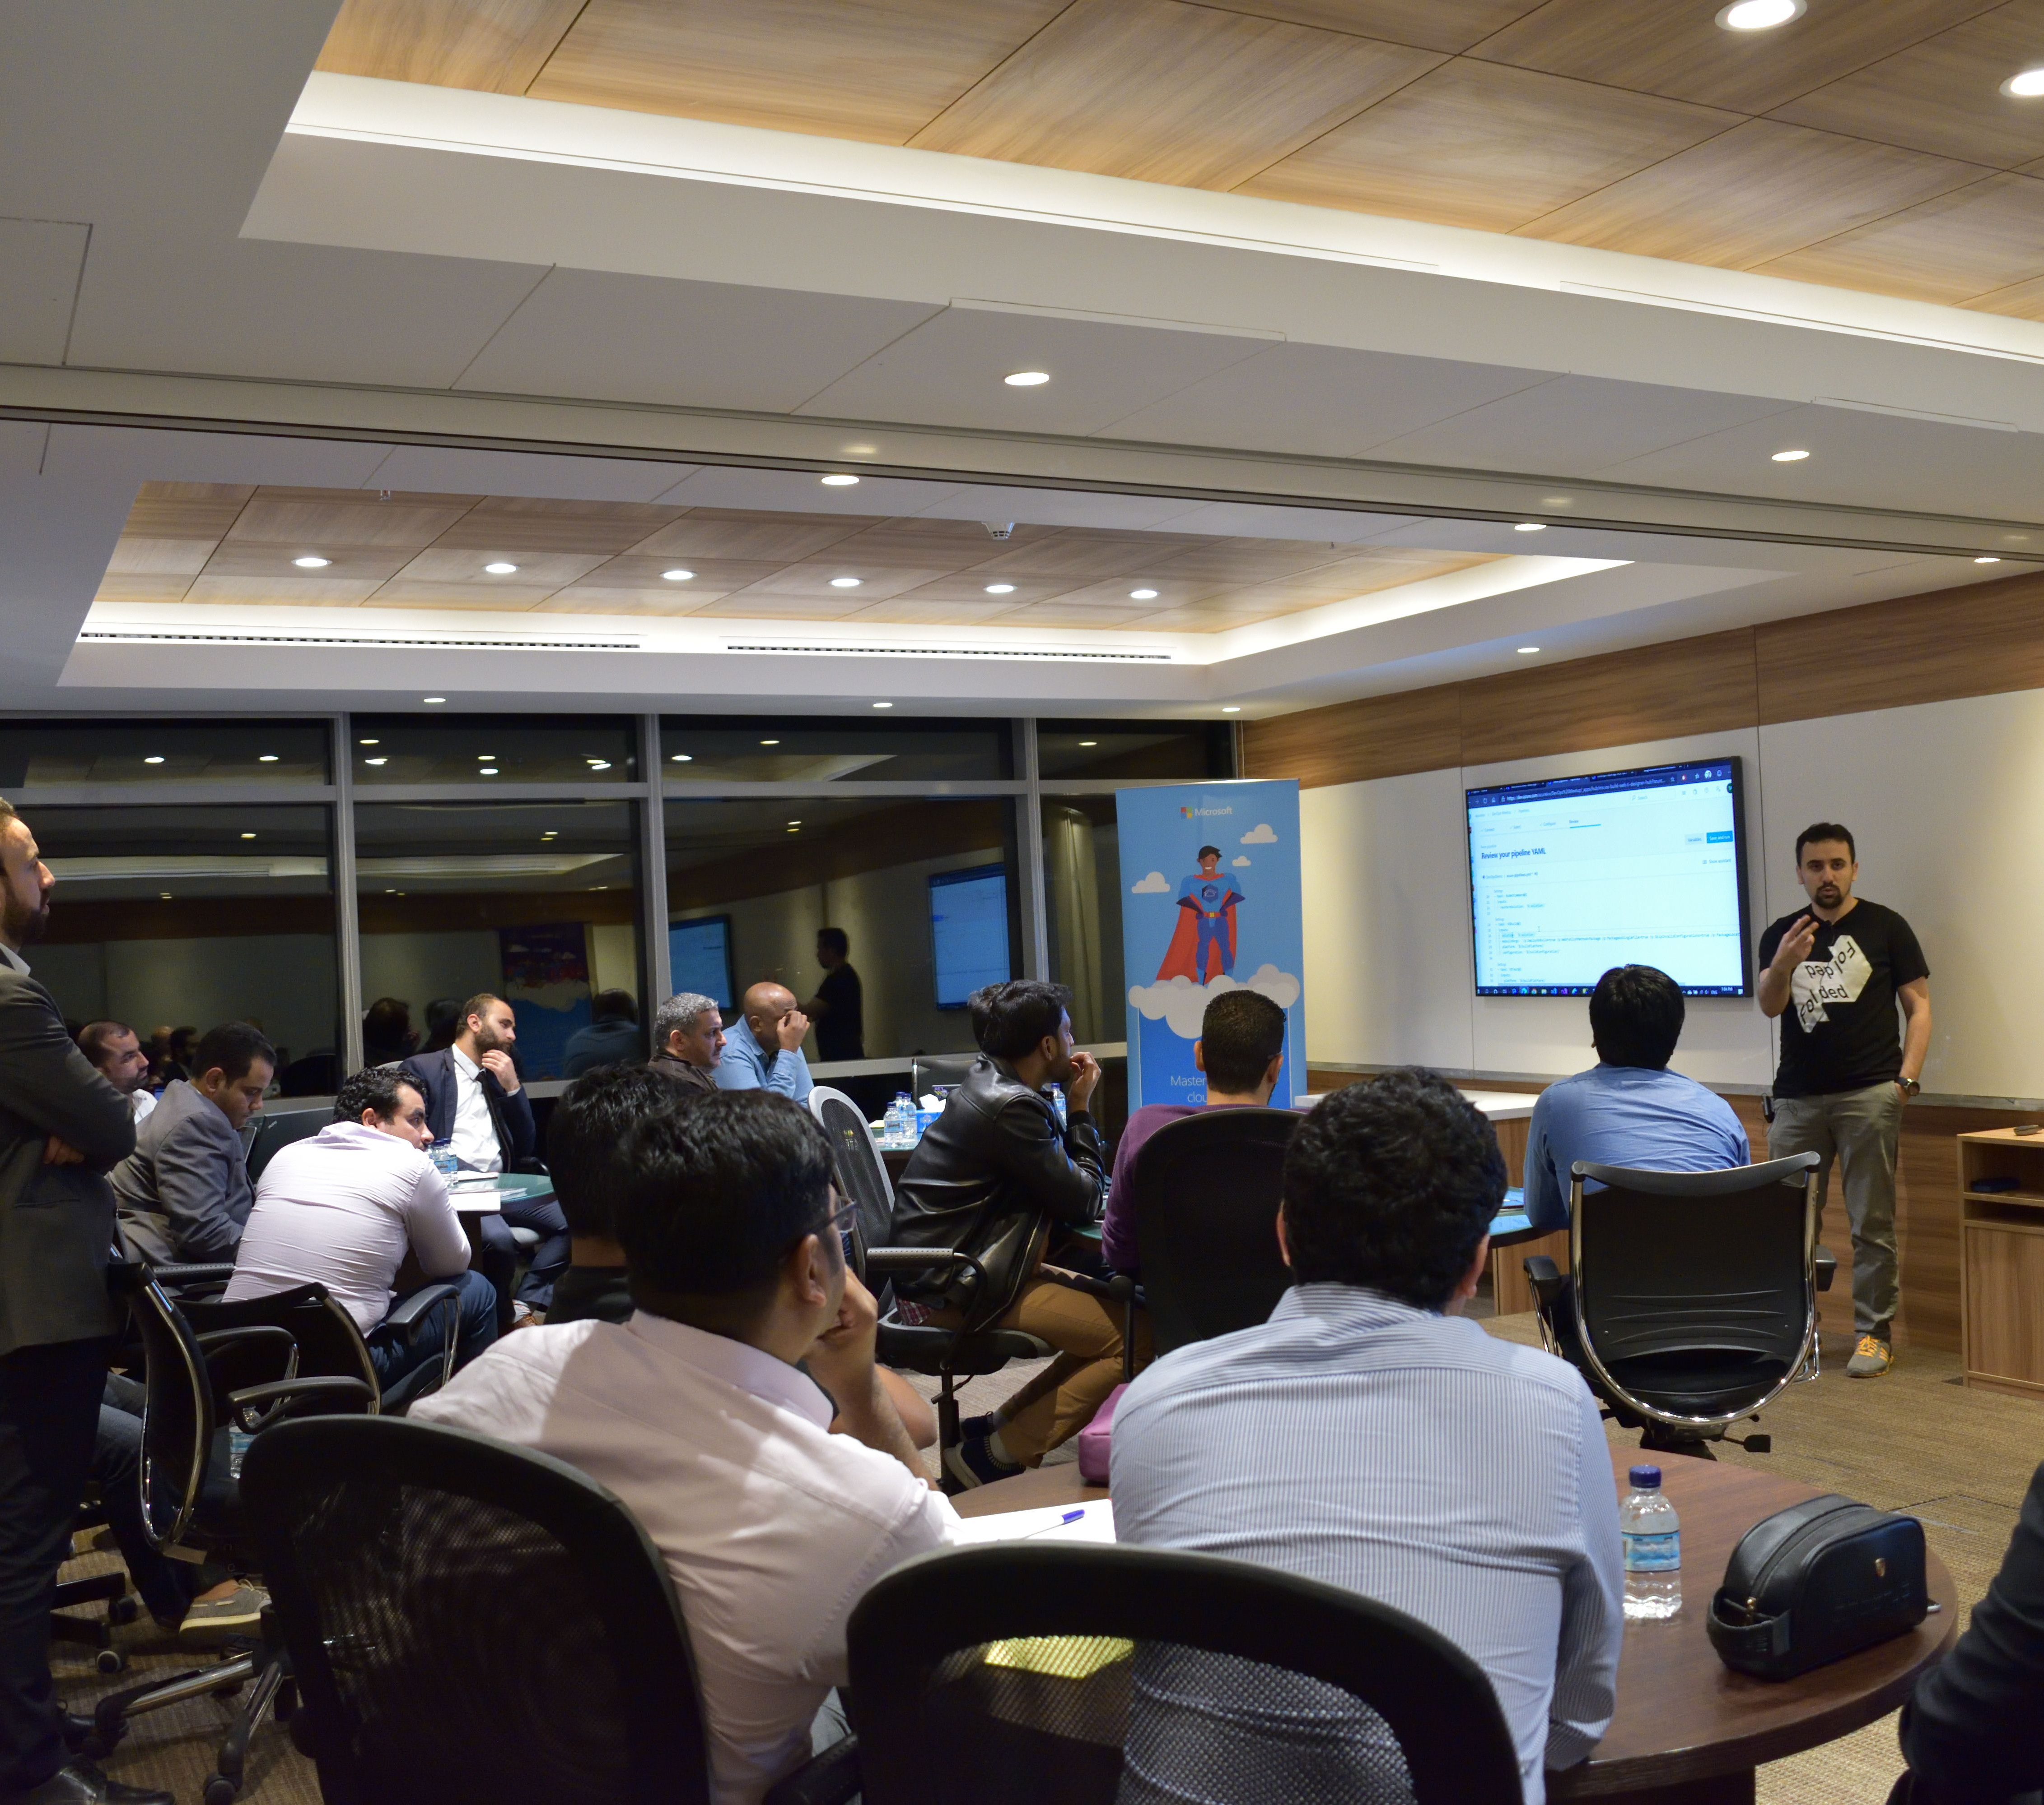
Azure Kuwait – Who are we?
Azure Kuwait is a community group to gather developers, technology enthusiasts from around Kuwait who are interested in Azure, .NET Core, Blazor, Open Source, Containerization, new technologies, etc to share experience, technology passion, learn from others, and have fun.

Slide 3
Azure Kuwait – What has been achieved so far?
July
2019
September
2019
Azure Tech Communities
300+
Member
7 Meetups

Slide 4
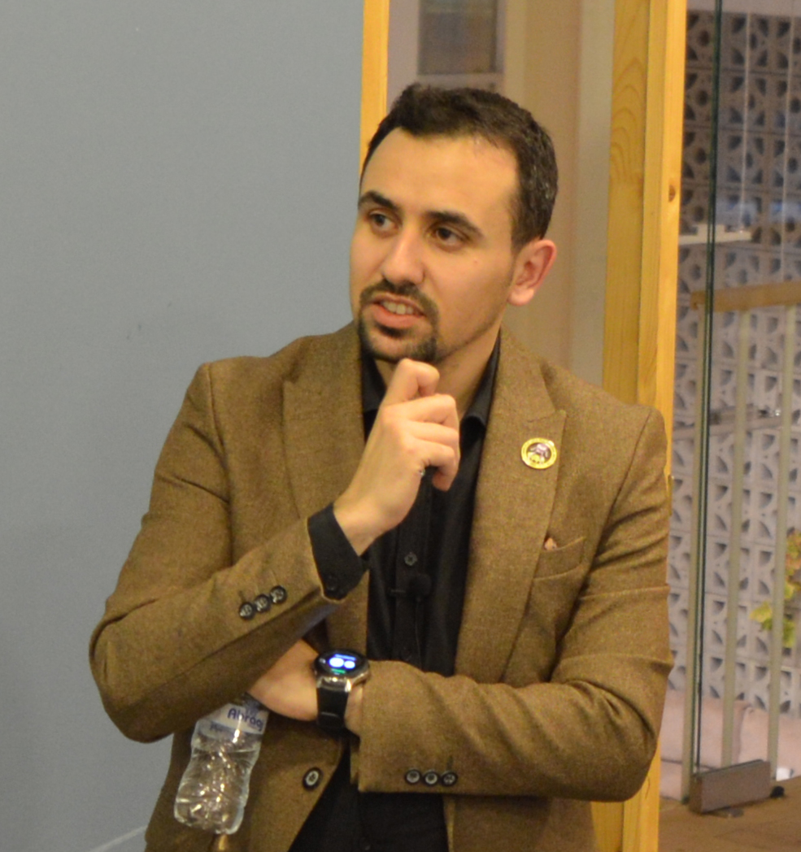


Tariq Abubaker
Overview
IT Enterprise Architect for Kuwait Finance House.
+10 years of experience in the IT and banking industry. I participated multiple projects range from SOA, EA, Core banking, Payment Solutions, Credit Cards, AML and Fraud, CRM, Retail, Finance, and IT service management solutions.
Azure Hero (Content and Community) badges holder.
Certifications
TOGAF® 9 Certified.
Azure Certified.
DevOps Certified.
ICAgile Certified Professional (ICP).
MCTS & MCP.
Contact Details
https://www.linkedin.com/in/tariq-abubaker/
@taq_abubaker

Slide 5
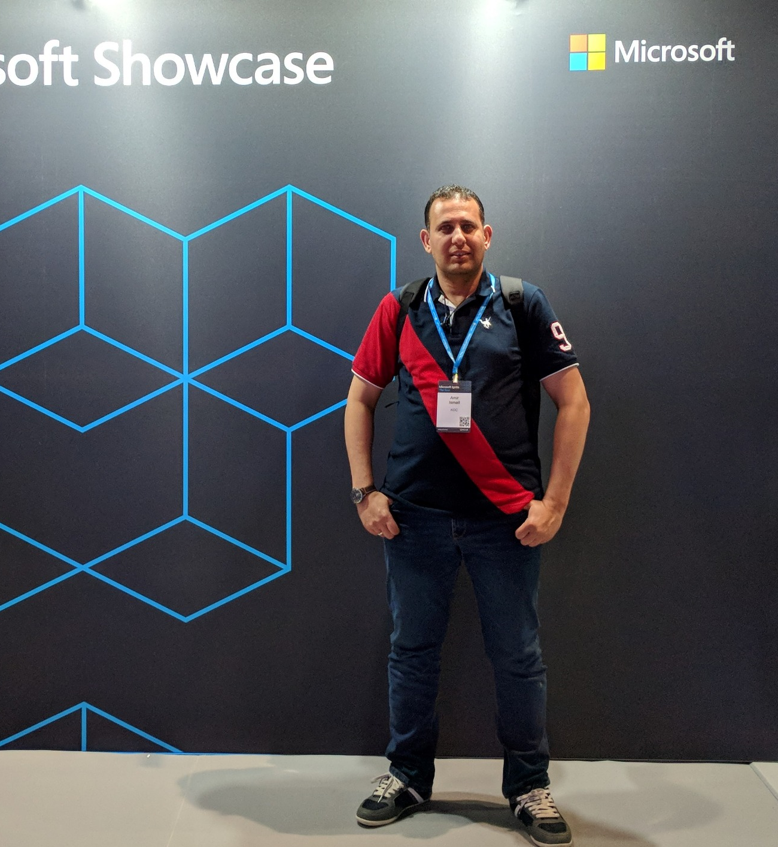
Amir Ismail
Overview
Senior Software Engineer for Kuwait Oil Company.
+15 years of experience in Software Engineering. I participated in multiple projects in different business domains range from E-learning, Banking, Oil, E-booing and Hotels management.
Certifications
PSM I Certified.
ITIL® Certified.
PRINCE2® Certified.
Contact Details
https://www.linkedin.com/in/amirismailyousef/

Slide 6
“Containers” & “Docker”
Why the buzz around them?
🤔

Slide 7
The software industry has changed
Monolithic Applications
Single Environment
Slowly Scaling Up/Out
Long Development Cycles
Decoupled Services
Fast, Iterative, Short Development Cycles
Multiple Environments
Quickly Scaling Up/Out
BEFORE
NOW

Slide 8
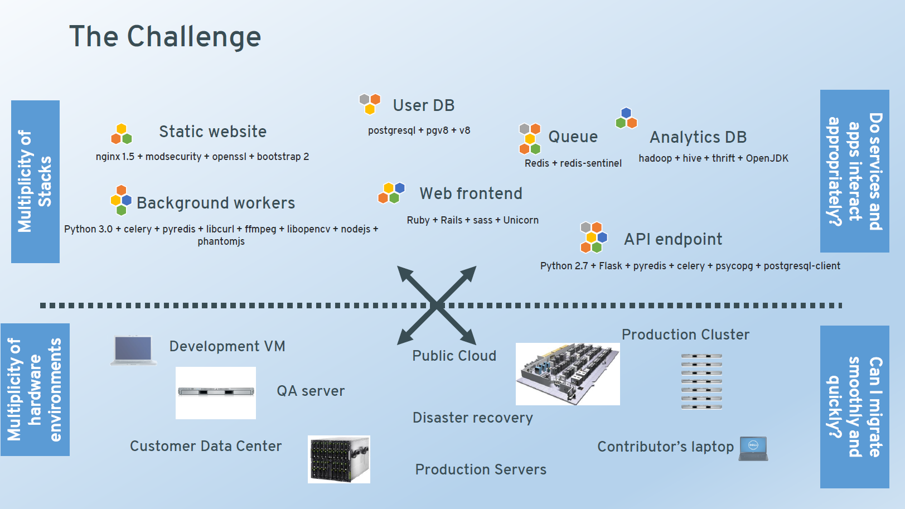
Deployment becomes very complex
Languages
Databases
Frameworks
Many Different Stacks
Individual Development Environments
Pre-Production, QA, Staging...
Production: On-Prem, Cloud, Hybrid
Many Different Targets

Slide 9
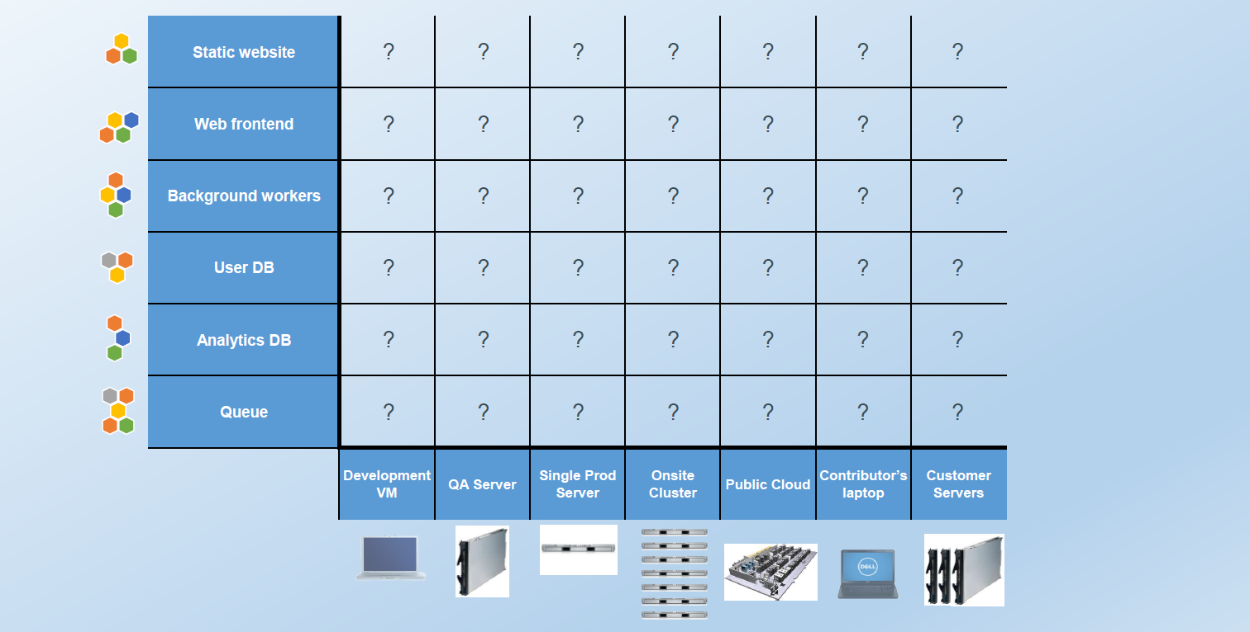
The matrix from hell

Slide 10
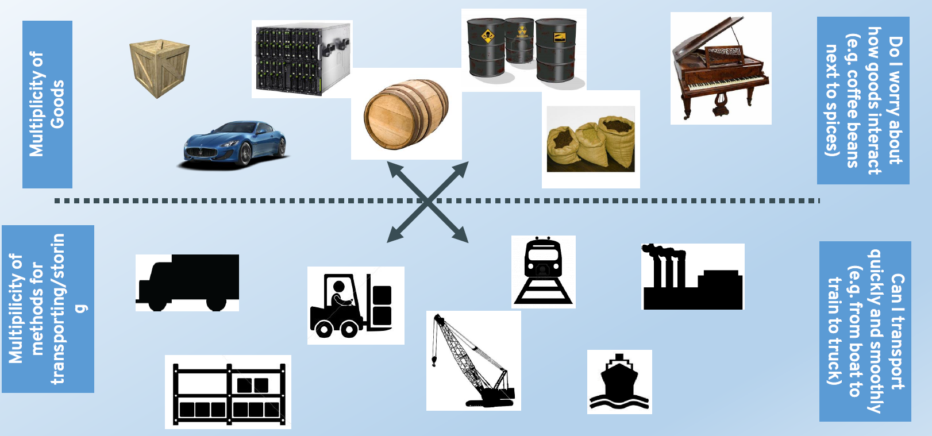
Cargo transport pre-1960

Slide 11
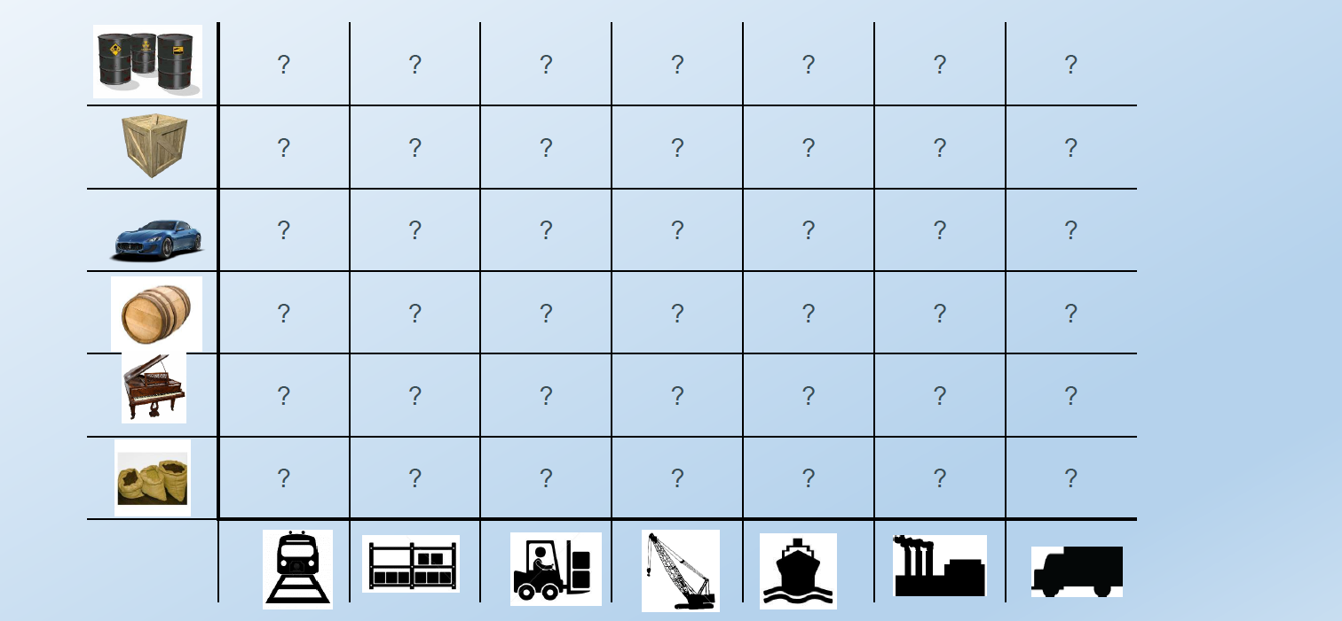
Also a matrix from hell

Slide 12
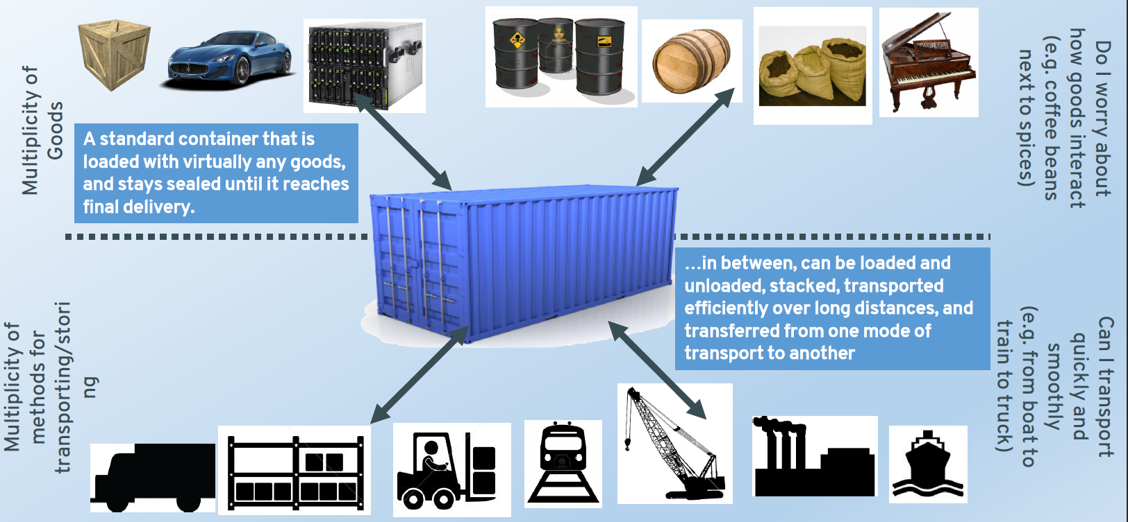
Solution: Intermodal shipping container

Slide 13
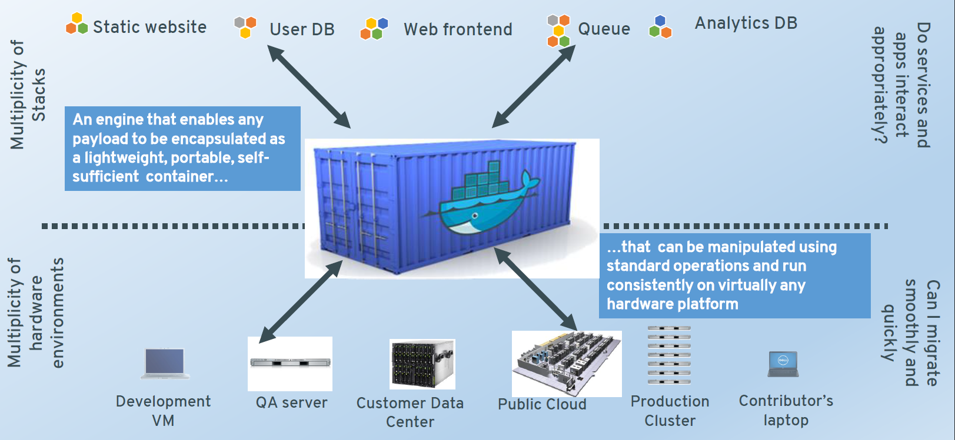
A shipping container system for applications

Slide 14
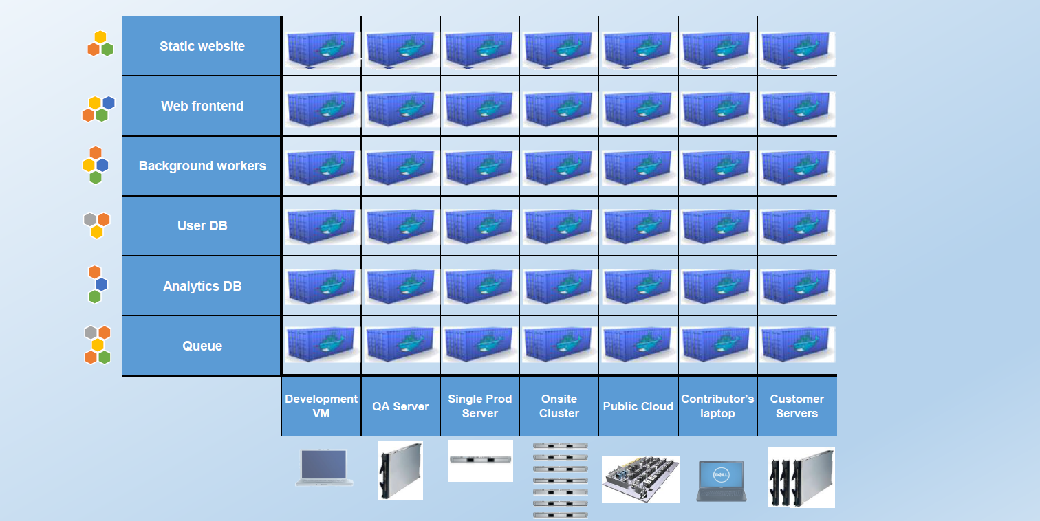
Eliminate the matrix from hell

Slide 15
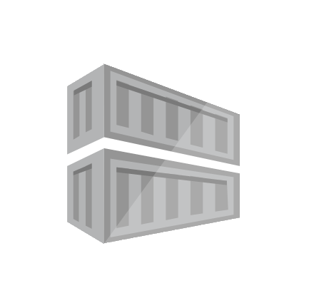
What is a Container?
A container is a standard unit of software that packages up code and all its dependencies, so the application runs quickly and reliably from one computing environment to another.
15

Slide 16
The Evolution of Container Technology
Docker is both a company and technology
While Docker has been playing a key role in adoption of the Linux container technology, they did not invent the concept of containers
However, they have made the technology consumable by mere humans
2004 Solaris Containers / Zones technology introduced
2008 Linux containers (LXC 1.0)
2013 Docker released to open source
2014 rkt
1979 UNIX V7 added chroot
2000 FreeBSD Jails
2001 Linux vserver
2005 openVZ
2006 Process Containers
2007 cgroups in Linux Kernel (2.6.24)
2007 AIX (6.1) WPARS
2011 Warden
2013 LMCTFY
2015 OCI

Slide 17
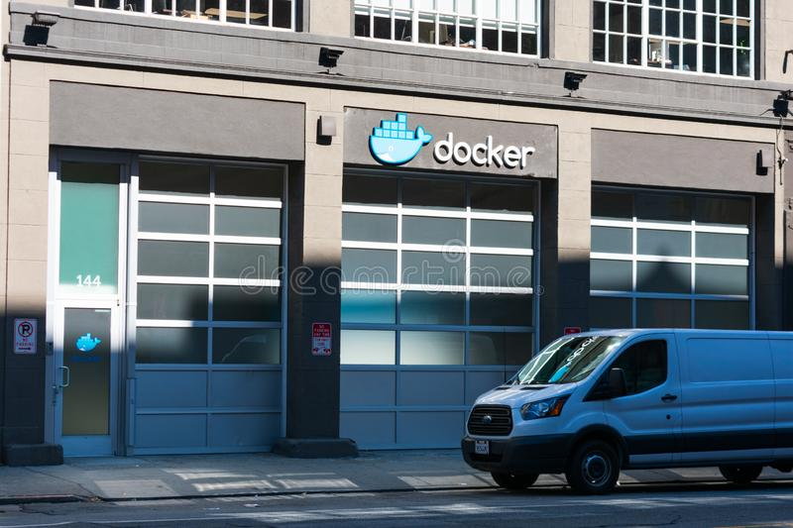
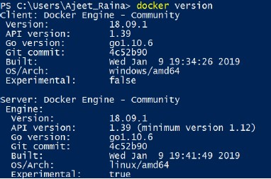
What is Docker?
Refers to several things in 2020
Docker as a “Company”
Docker as a “Product”
Docker as a “Platform”
Docker as a “CLI Tool”
Docker as a “Computer Program”
17

Slide 18
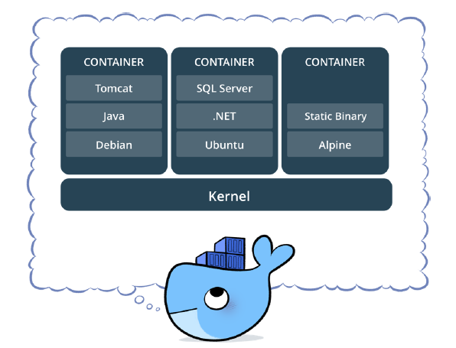
What is Docker?
Standardized packaging for software and dependencies
Isolate apps from each other
Share the same OS kernel
Works for all major Linux distributions
Containers native to Windows Server 2016 & 2019
18

Slide 19
Docker Containers vs. VMs
Containers are isolated, but share OS and, where appropriate, bins/libraries
Result is significantly faster deployment, much less overhead, easier migration, faster restart

Slide 20
Docker Containers vs. VMs
Each VM runs its own OS
Boot up time is in minutes
VMs snapshots are used sparingly
Not effective diffs. Not version controlled
Cannot run more than couple of VMs on an average laptop
Only one VM can be started from one set of VMX and VMDK files
Virtual Machines
Container is just a user space of OS
Containers instantiate in seconds
Images are built incrementally on top of another like layers. Lots of images/snapshots
Images can be diffed and can be version controlled. Docker hub is like GITHUB
Can run many Docker containers in a laptop
Multiple Docker containers can be started from one Docker image
Docker Containers

Slide 21
Docker Vocabulary
Docker Image
Docker Engine
Docker Container
The basis of a Docker container.
Represent a full application.
The standard unit in which the application service resides and executes
Creates, ships and runs Docker containers deployable on a physical or virtual, host locally, in a datacenter or cloud service provider
Registry Service (Docker Hub or ACR)
Cloud or server-based storage and distribution service for your images

Slide 22
Docker Basic Commands - Images
Pull an image or a repository from a registry
docker image pull [OPTIONS] NAME[:TAG|@DIGEST]
Example:
docker image pull mcr.microsoft.com/dotnet/core/samples:aspnetapp
Push an image or a repository to a registry
docker image push [OPTIONS] NAME[:TAG]
Example:
docker image push mcr.microsoft.com/dotnet/core/samples:aspnetapp
List image
docker image list [OPTIONS] [REPOSITORY[:TAG]]
Example:
docker image list
docker image ls
docker image ls -a

Slide 23
Docker Basic Commands - Images
Remove one or more images
docker image rm [OPTIONS] IMAGE [IMAGE...]
Example:
docker image rm mcr.microsoft.com/dotnet/core/samples:aspnetapp
docker image remove mcr.microsoft.com/dotnet/core/samples:aspnetapp

Slide 24
Docker Basic Commands - Containers
Run a command in a new container
docker container run [OPTIONS] IMAGE [COMMAND] [ARG...]
Example:
docker container run mcr.microsoft.com/dotnet/core/samples:aspnetapp
docker container run -p 8080:80 -d mcr.microsoft.com/dotnet/core/samples:aspnetapp
Stop one or more running containers
docker container stop [OPTIONS] CONTAINER [CONTAINER...]
Example:
docker container stop 8d9e6128bc50
docker container stop elegant_ramanujan
Start one or more stopped containers
docker container start [OPTIONS] CONTAINER [CONTAINER...]
Example:
docker container start 8d9e6128bc50
docker container start elegant_Ramanujan

Slide 25
Docker Basic Commands - Containers
Remove one or more containers
docker container rm [OPTIONS] CONTAINER [CONTAINER...]
Example:
docker container rm 8d9e6128bc50
docker container rm elegant_Ramanujan
docker container rm -f 8d9e6128bc50
List containers
docker container ls [OPTIONS]
Example:
docker container ls
docker container list
docker container ps
docker container ls -a

Slide 26
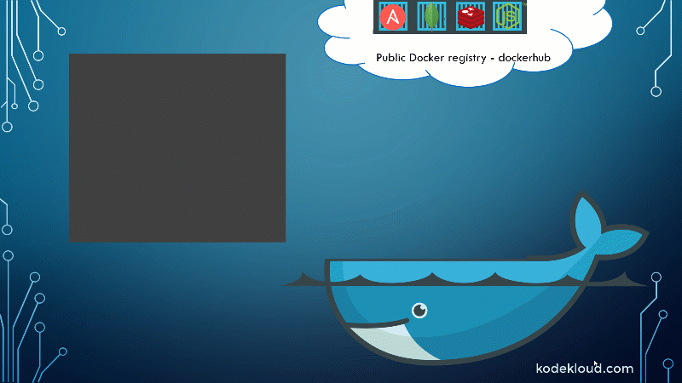
Demo

Slide 27
Demos
Show docker hub.
Show the Windows containers and Linux Containers
Small brief about command structure.
pull an image
docker image list
docker pull mcr.microsoft.com/dotnet/core/samples:aspnetapp
Run a Docker container
docker container run mcr.microsoft.com/dotnet/core/samples:aspnetapp
docker container run -p 8080:80 -d mcr.microsoft.com/dotnet/core/samples:aspnetapp
Highlight the “-p” and “-d” parameters
docker container stop elegant_ramanujan
docker container start elegant_Ramanujan
docker container rm elegant_Ramanujan → docker container rm -f elegant_Ramanujan
Remove Docker images
docker image rm mcr.microsoft.com/dotnet/core/samples:aspnetapp
Containers and files
Mention volumes
Manage Docker containers
docker ps → docker container ls

Slide 28
Create your Docker image
Manually completing this process is time-consuming and error-prone. It could be scripted with a script language like Bash, but Docker provides a more effective way of automating image creation via
A Dockerfile.
Identify a base image
Start a container with the base image and make changes to it
Commit changes and save them to a new image

Slide 29
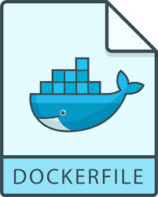
What is a Dockerfile?
A Dockerfile is a plain text file containing all the commands needed to build an image. Dockerfiles are written in a minimal scripting language designed for building and configuring images, and documents the operations required to build an image starting with a base image.
29

Slide 30
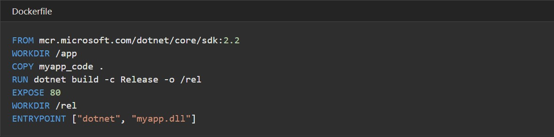
Dockerfile Example

Slide 31
Build Dockerfile
Build an image from a Dockerfile
docker build [OPTIONS] PATH | URL | -
Example:
docker build .
docker build -t myapp:v1 .
docker build -t myapp:v1 -t myapp:latest ./samples/

Slide 32
Demo

Slide 33
What is Azure Container Registry (ACR)?
Azure Container Registry is a managed, private Docker registry service based on the open-source Docker Registry 2.0.
33

Slide 34
What is Azure Container Instances (ACI)?
Azure Container Instances is a great solution for any scenario that can operate in isolated containers, including simple applications, task automation, and build jobs.
34

Slide 35
Tag your images with different tags & repositories
Create a tag TARGET_IMAGE that refers to SOURCE_IMAGE
docker tag SOURCE_IMAGE[:TAG] TARGET_IMAGE[:TAG]
Example:
docker tag myapp:v1 myregistry.azurecr.io/myapp:v1
docker tag myapp:v1 myapp:web

Slide 36
Demo

Slide 37


Contact Us
@azure_q8
@azure_q8

Slide 38

SCAN THE CODE & START YOUR Migration today
https://aka.ms/AA6923d
38

Slide 39

SCAN THE CODE & SEND US YOUR FEEDBACK!
https://www.surveymonkey.com/r/FZQSBX6
39

Slide 40
Resources
https://docs.microsoft.com/en-us/learn/modules/intro-to-containers/
https://www.docker.com/
https://docs.docker.com/
https://www.slideshare.net/dotCloud/docker-intro-november
https://qconsf2017intro.container.training/
https://www.slideshare.net/Docker/introduction-to-docker-2017
https://www.slideshare.net/adityakonarde/introduction-to-docker-63666306?qid=eed0967c-81ac-46c5-ba8d-bd79f8ce67e4&v=&b=&from_search=4

Slide 41
Q&A Thank You!

